Slide 1
32
1x1
Conv
upsample
A
B
64
fuse
module
fuse module
128
concat
3x3 Conv
dropout = 0.3
256
32
1x1
Conv

Slide 2
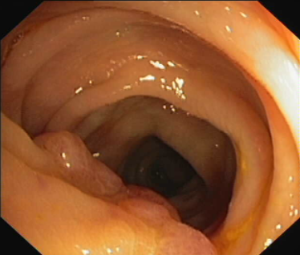
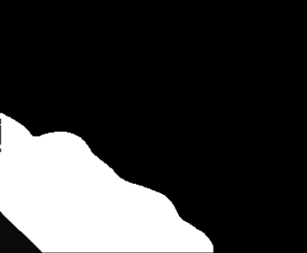
1x1
Conv
3x3 Conv
dilation = 2
Image Pooling
3x3 Conv
dilation = 18
3x3 Conv
dilation = 12
3x3 Conv
dilation = 6
1x1
Conv
3x3 Conv
3x3 Conv
dilation = 3
3x3 Conv
dilation = 6
concat
add
add
attention
Encoder
downsampled
patch block
downsampled
patch block
patch block
patch block
downsampled
downsampled
5x5 Conv
stride = 2
Decoder
upsample
by 8
concat
3x3 Conv
dropout = 0.3
1x1 Conv
1x1 Conv
upsample
by 2

Slide 3
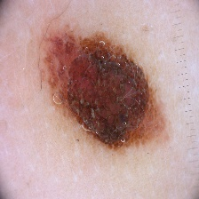
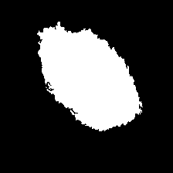
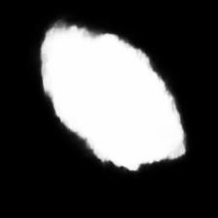
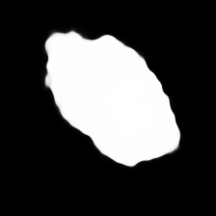
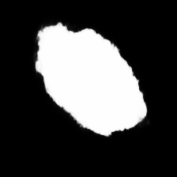
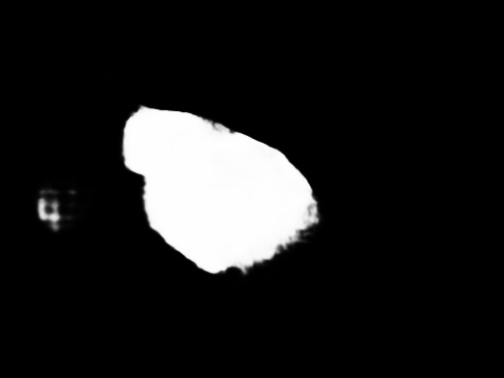
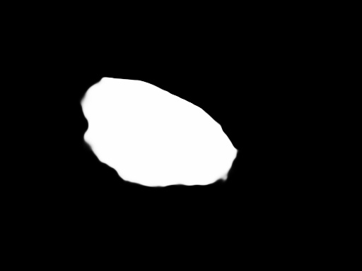
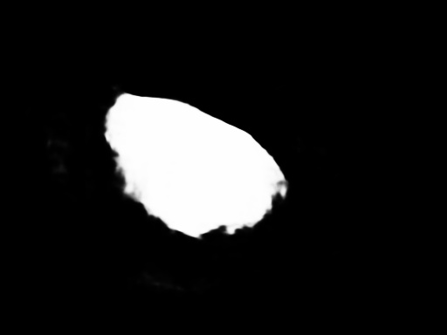
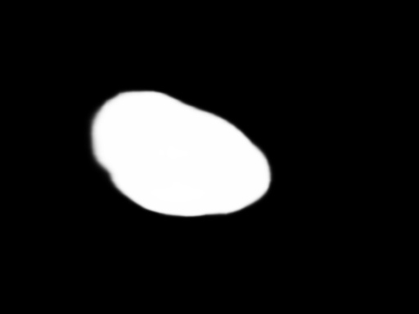
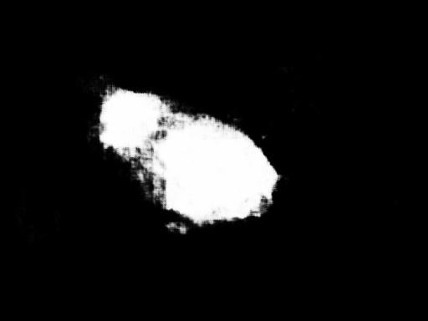
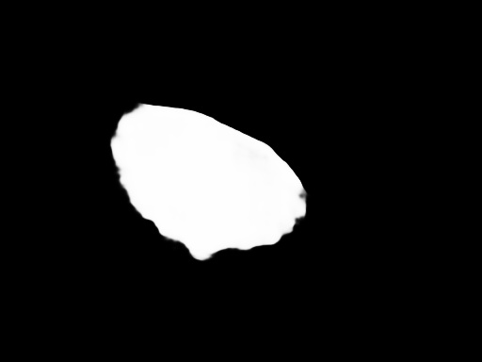
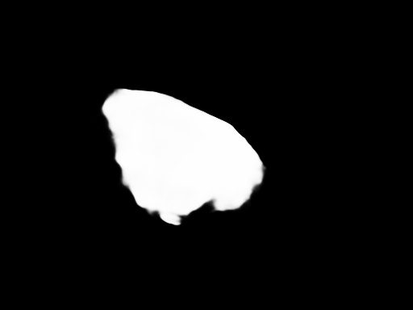
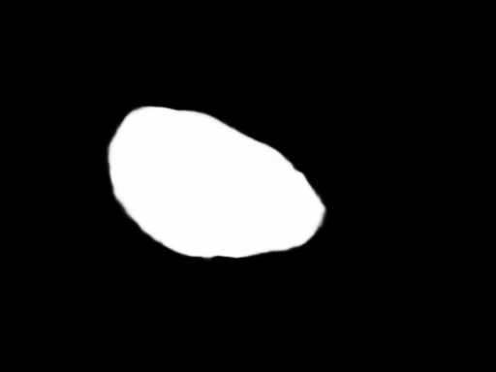
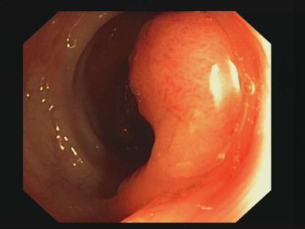

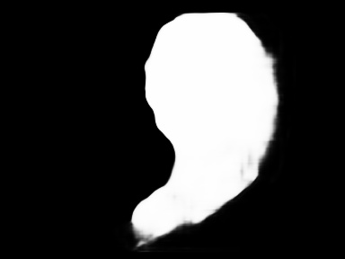
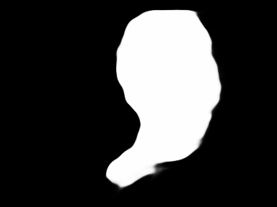


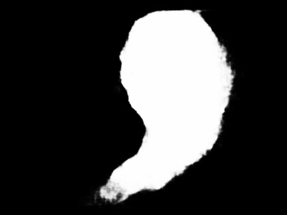
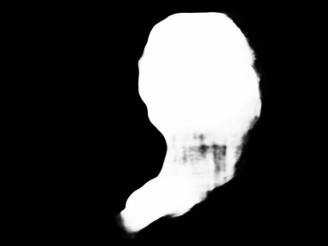
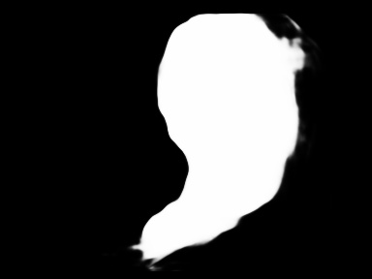

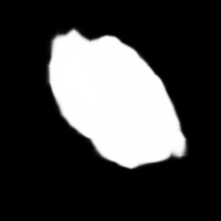
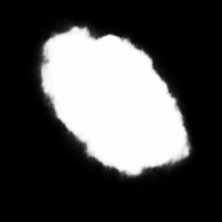
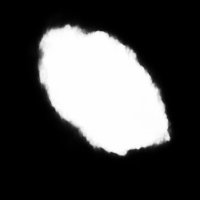

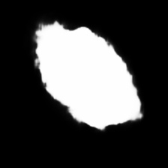

Slide 4
Dataset | CVC |  | ETIS |  | Skin
Methods | iou | dice | iou | dice | iou | dice
PNet（3x3） | 0.9176 | 0.9501 | 0.8938 | 0.9364 | 0.8820 | 0.9240
PNet（pool） | 0.9283 | 0.9565 | 0.9258 | 0.9567 | 0.8809 | 0.9242
PNet（5x5） | 0.9332 | 0.9599 | 0.9405 | 0.9646 | 0.8946 | 0.9340
Dataset | CVC |  | ETIS |  | Skin
Methods | iou | dice | iou | dice | iou | dice
PNet（25） | 0.9187 | 0.9506 | 0.9308 | 0.9594 | 0.8653 | 0.9134
PNet（26） | 0.9332 | 0.9599 | 0.9405 | 0.9646 | 0.8946 | 0.9340
PNet（27） | 0.9289 | 0.9573 | 0.9287 | 0.9579 | 0.8885 | 0.9300
PNet（38） | 0.9166 | 0.9501 | 0.9048 | 0.9443 | 0.8898 | 0.9292

